Slide 1


Department of Information Science and Engineering
Department of Information Science and Engineering
DOMAIN - CLOUD COMPUTING
PHASE-II
ABHISHEK ANAND 1NT18IS006
ABHISHEK SINGH 1NT18IS009
SAHANA RAJ 1NT18IS132
KS SAIVAIBHAV 1NT18IS074
MENTORED BY-
MR. KIRAN B R
ASST PROFESSOR,NMIT
19-05-2021

Slide 2
OBJECTIVES
Build cloud environment using containers and virtual machine
Compare the performance of map-reduce workload execution in virtualized , containerized environment.
Compare the performance of map-reduce workload execution in mixed (virtualized , containerized) environment
To evaluate and compare the performance of executing the workload in the mixed environment as well as the virtualized , containerized environment independently

Slide 3
PROBLEM STATEMENT
Performance analysis of executing map-reduce workload in a containerized and virtualized cloud environment

Slide 4
SYSTEM DESIGN
CLIENT
VM1
VM2
VM3
VM4
RESOURCE MANAGER
COMMUNICATION NODE
CONTAINER 1
CONTAINER 2
CONTAINER 3
CLIENT

Slide 5
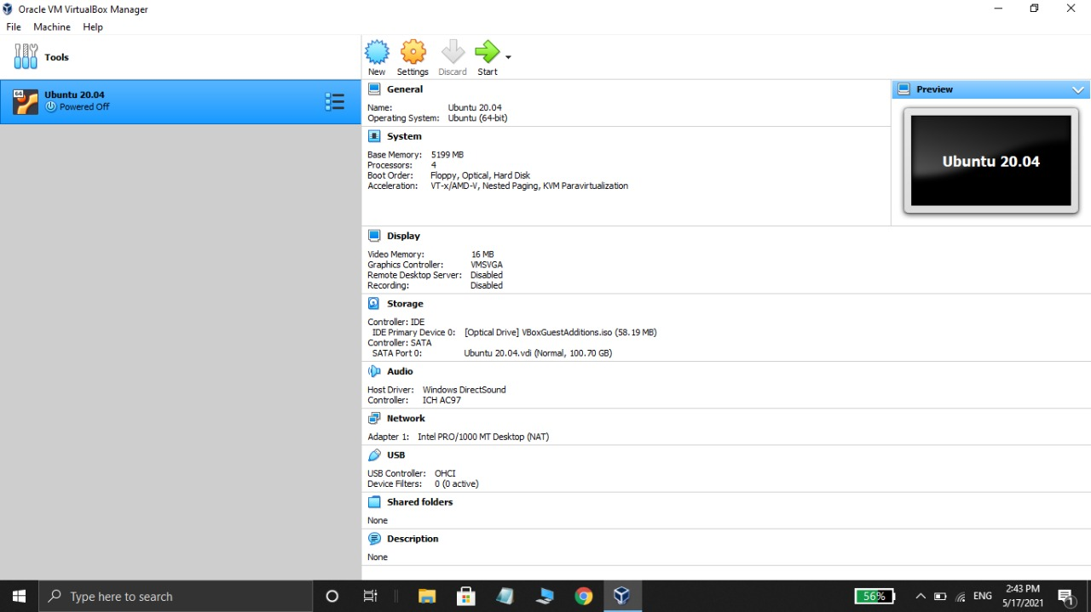

Slide 6
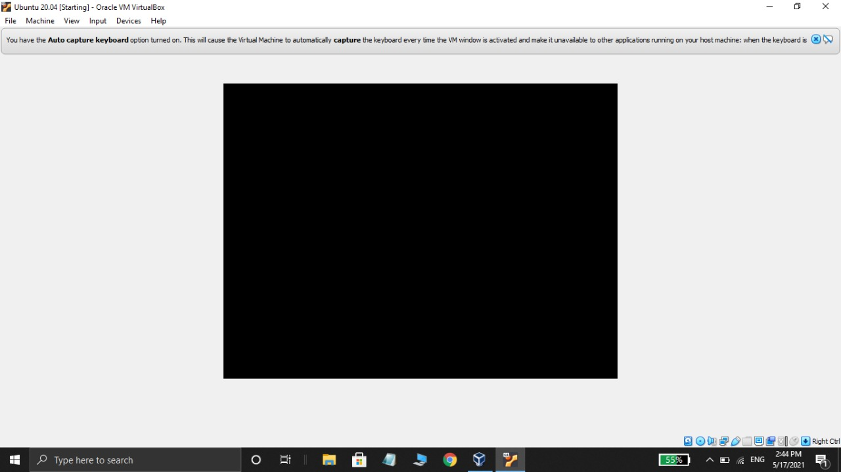

Slide 7
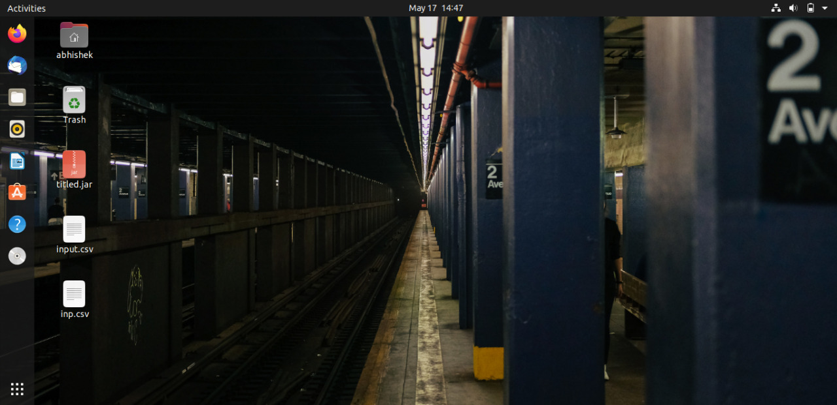

Slide 8
IMPLEMENTATION
Deploying Kubernetes on a Two-node Ubuntu cluster
The two-node cluster that we will be forming will consist of a Master node
and Slave node.
Both these nodes need to have Kubernetes installed on them.
Step 1: Install Docker on both the nodes
$ sudo apt install docker.io
$ docker --version

Slide 9
IMPLEMENTATION
Step 2: Enable Docker on both the nodes
$ sudo systemctl enable docker
Step 3: Add the Kubernetes signing key on both the nodes
$ curl -s https://packages.cloud.google.com/apt/doc/apt-key.gpg | sudo apt-key add
$ sudo apt install curl
Step 4: Add Xenial Kubernetes Repository on both the nodes
$ sudo apt-add-repository "deb http://apt.kubernetes.io/ kubernetes- xenial main"

Slide 10
IMPLEMENTATION
Step 5: Install Kubeadm
$ sudo apt install kubeadm
$ kubeadm version
Kubernetes Deployment
Step 1: Disable swap memory (if running) on both the nodes
$ sudo swapoff -a
Step 2: Give Unique hostnames to each node
Master Node- $ sudo hostnamectl set-hostname master-node
Slave Node- $ sudo hostnamectl set-hostname slave-node

Slide 11
IMPLEMENTATION
Step3: Initialize Kubernetes on the master node
$ sudo kubeadm init --pod-network-cidr=10.244.0.0/16
mkdir -p $HOME/.kube
sudo cp -i /etc/kubernetes/admin.conf $HOME/.kube/config
sudo chown $(id -u):$(id -g) $HOME/.kube/config
We can join any number of machines by running the following on each node-
kubeadm join 192.168.1.106:6443 --token xzxnoe.5rnh12dvvr4lo1ov \ --discovery-token-ca-cert-hash sha256:0c205051c6745e74123531d871e5c24a66f8873d23badc180adf b7de8b2a67f

Slide 12
IMPLEMENTATION
$ kubectl get nodes
Step 4: Deploy a Pod Network through the master node
$ sudo kubectl apply -f https://raw.githubusercontent.com/coreos/flannel/master/Docume ntation/kube-flannel.yml
$ kubectl get pods --all-namespaces
$ sudo kubectl get nodes

Slide 13
IMPLEMENTATION
Step 5: Add the slave node to the network in order to form a cluster
$sudo kubeadm join 192.168.1.106:6443 --token xzxnoe.5rnh12dvvr4lo1ov \--discovery-token-ca-cert-hash sha256:0c205051c6745e74123531d871e5c24a66f8873d23badc180ad ffb7de8b2a67f
$ sudo kubectl get nodes

Slide 14
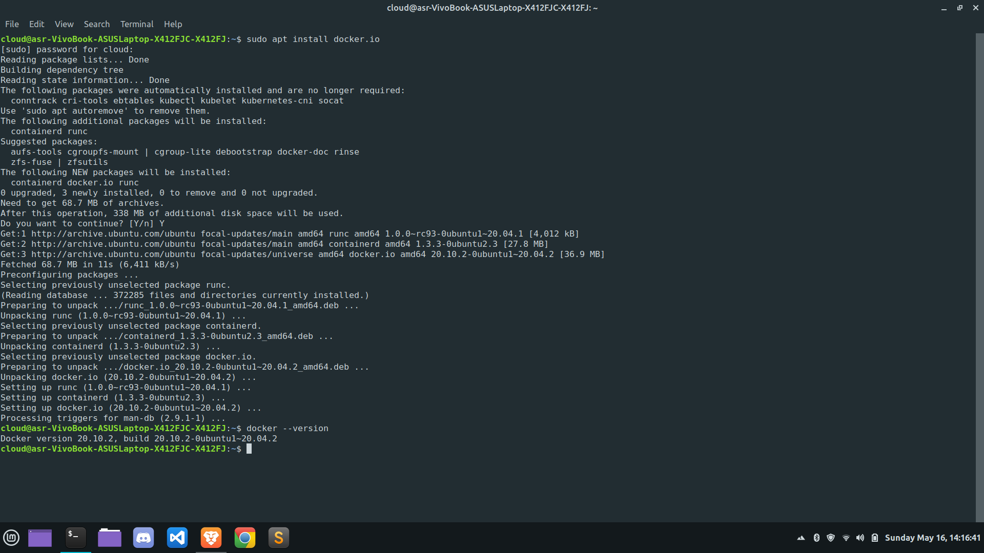

Slide 15
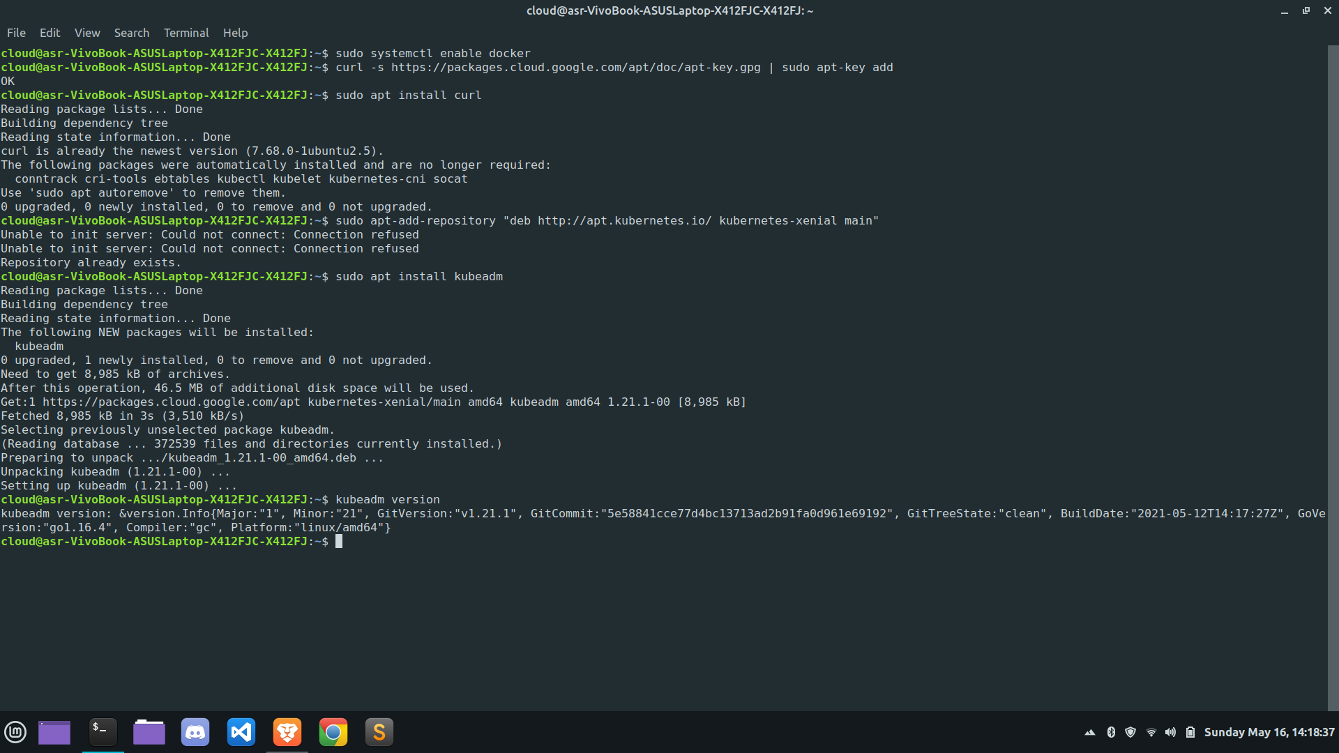

Slide 16
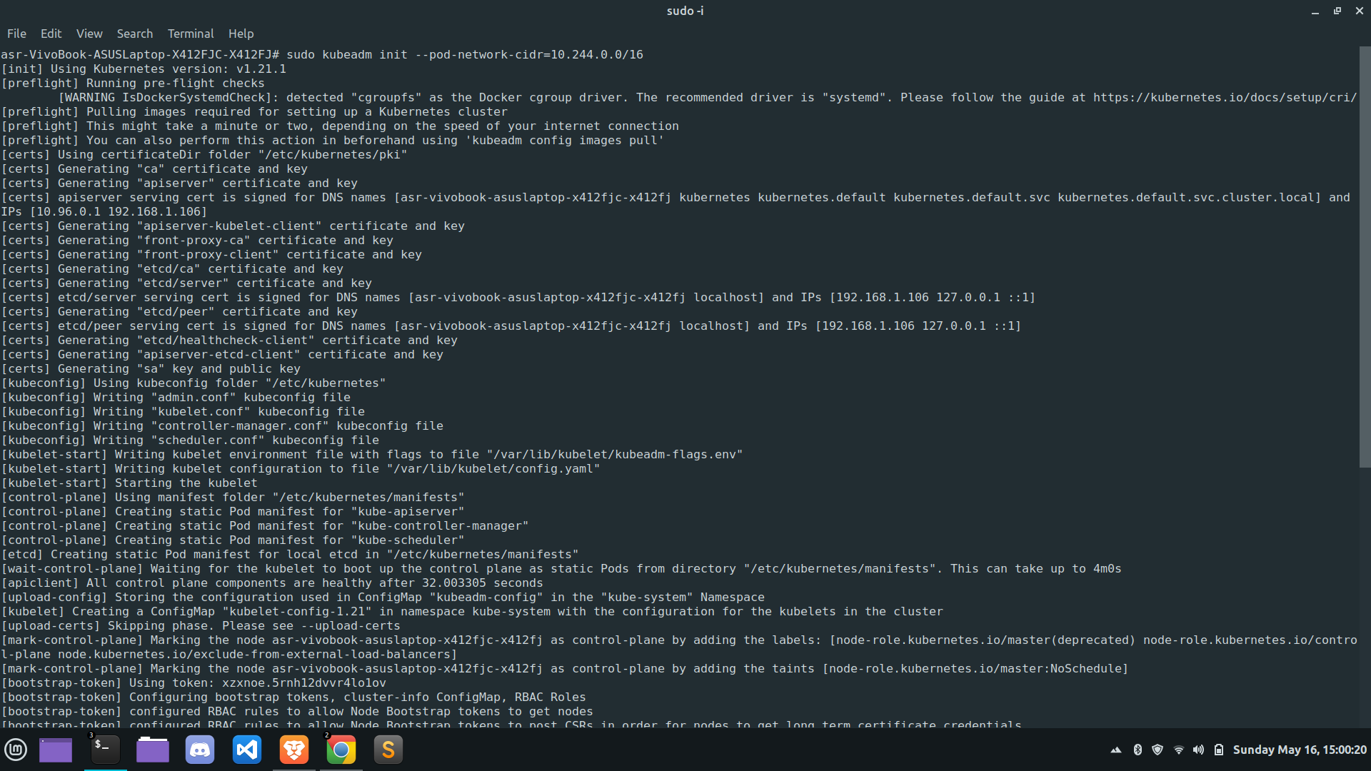

Slide 17
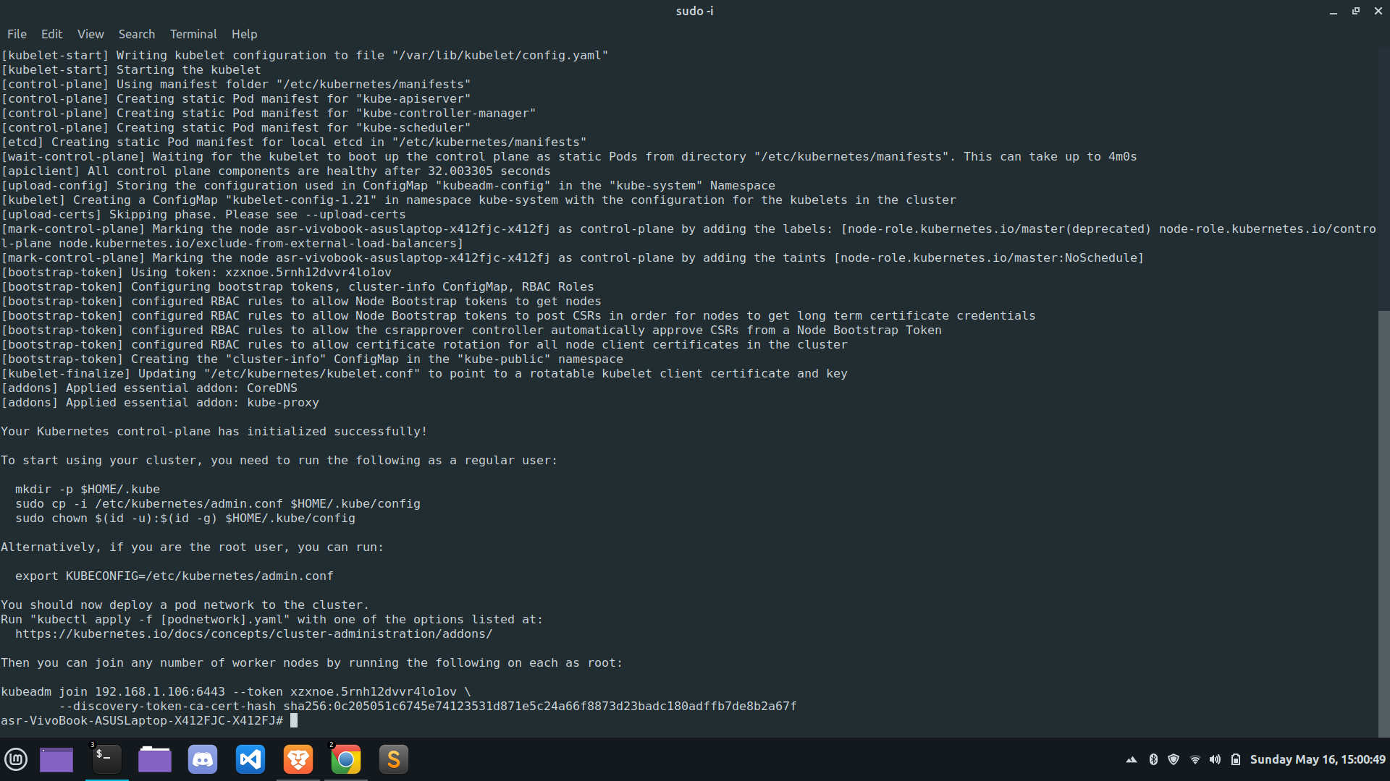

Slide 18
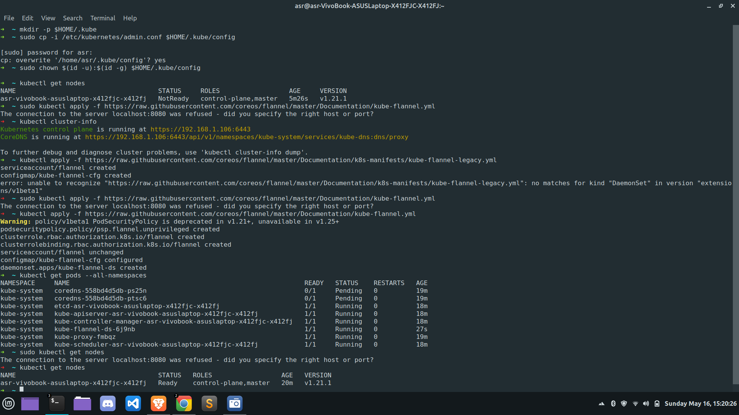

Slide 19
LITERATURE SURVEY
TITLE - Container Mixed Environment using Service Mesh
AUTHORS - Hokeun Lim Younghan and Kim Kyoungjae Su
KEYWORDS - MSA, Istio, Tacker, OpenStack, Kubernetes
SUMMARY-
A microservice architecture is that structure in which a service model that separates a service focused on performing one function into the smallest

Slide 20
SUMMARY
independent and deployable service, connects with other services through API
B. In this paper, we proposed an orchestrator and structure for service management in a virtual machine and container mixed environment using a service mesh.
C. There is some case that using container and virtual machine together, but the current service mesh architecture only consider container environment, and if a virtual machine is to be used, the user must proceed manually.
D. An additional structure is required to automate proxy deployment in virtual machines.

Slide 21
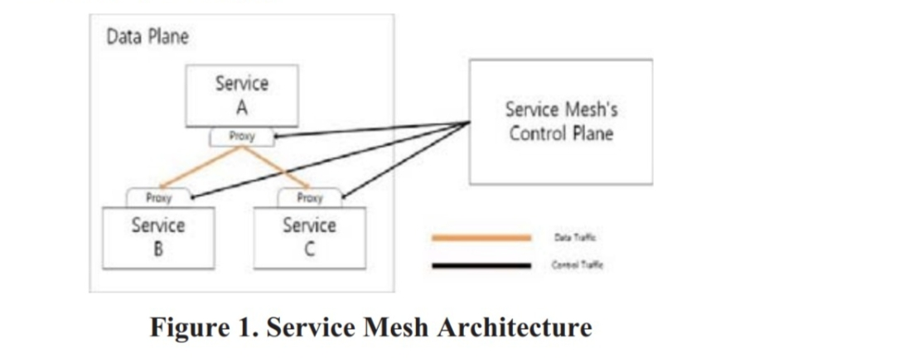
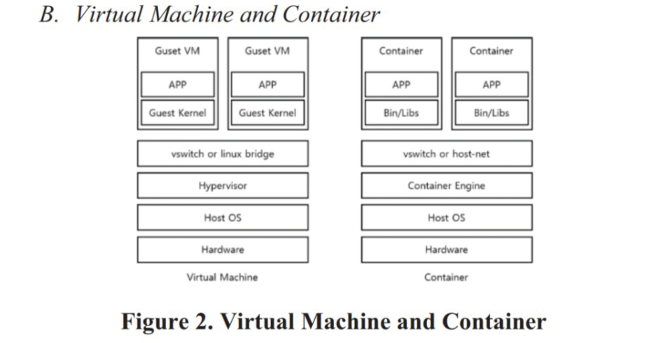
SUMMARY

Slide 22
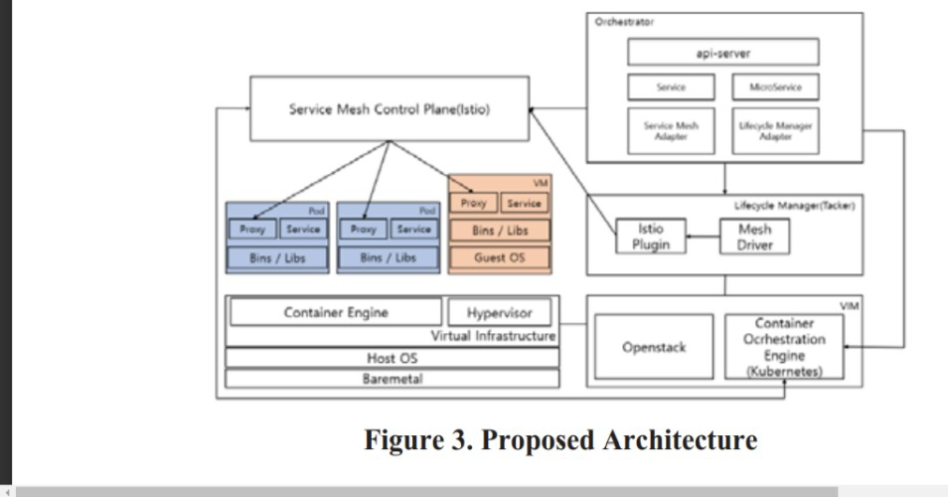
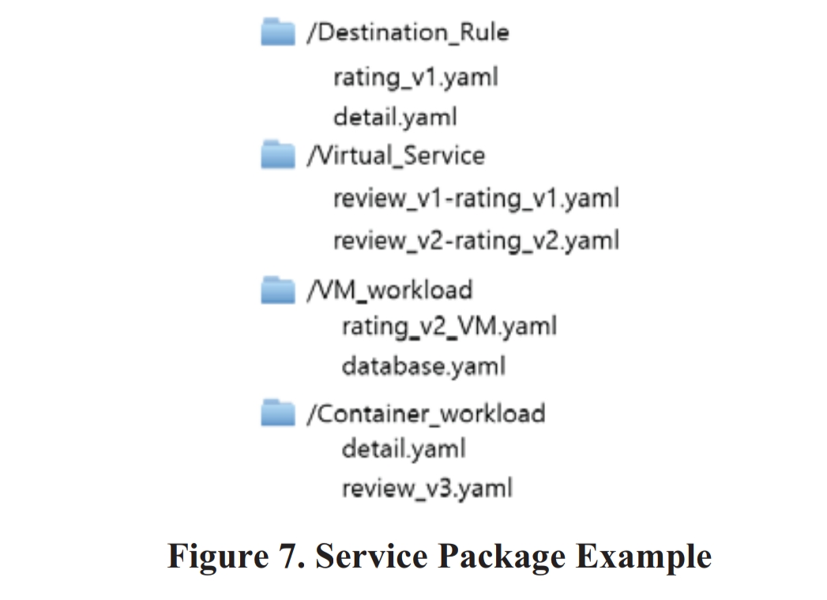
SUMMARY

Slide 23
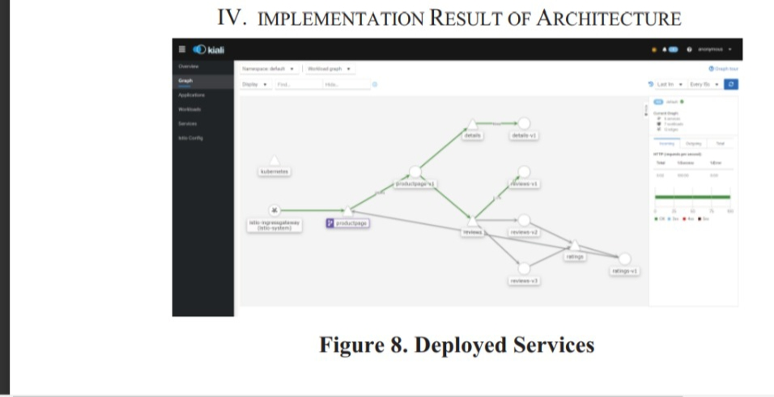
SUMMARY

Slide 24
LITERATURE SURVEY
TITLE - Comparitive Study of Hadoop over Containers and Hadoop Over Virtual Machine
AUTHORS - Avanish Singh, P. Gouthaman, Shivankit Bagla and Abhishek Dey
SUMMARY -
The main aim of this paper is to elaborate the concept of Containerization which enables usage of Hadoop Infrastructure on a container which can allow clusters to run rapidly fast and accessible manner and it can be used for installing, processing and monitoring/analysis of Big Data under various configurations

Slide 25
SUMMARY
B . As researched and stated that container application run much faster whereas the virtual machine which runs on a indipendant OS runs slower.
C. The current world uses the standard procedures to optimise the big data, which perhaps is the next big thing, but using Hadoop frameworks on containers, decreases the downtime of a system incase of failure or starting

Slide 26
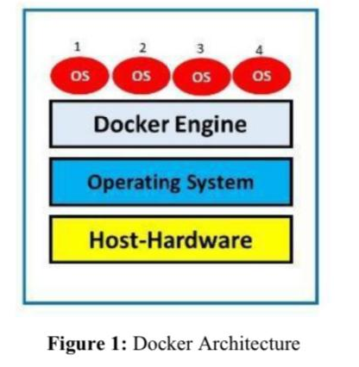
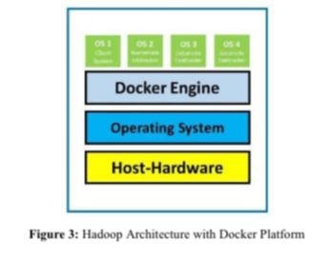
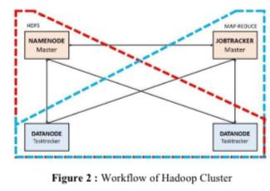
SUMMARY

Slide 27
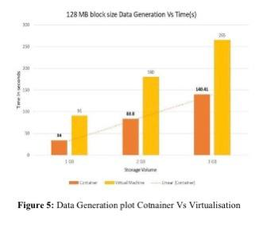
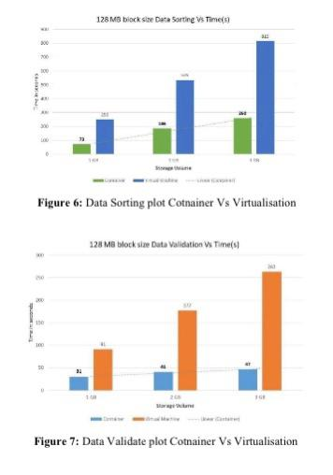
SUMMARY

Slide 28
LITERATURE SURVEY
TITLE - Comparative Study of Containers and Virtual Machines in Big Data Environment
AUTHORS - Qi Zhang , Ling Liu , Calton Pu , Qiwei Dou , Liren Wu, and Wei Zhou
SUMMARY -
1) There are still lacks in-depth and systematic comparison study on how big data applications,such as Spark jobs, perform between a container and a virtual machine.
2) Running various applications with different configurations, evaluate the two environments onmany aspects, such as how execution ,makespans and hardware resources and how well each environment can scale.

Slide 29
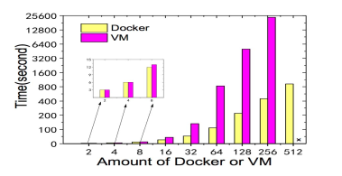
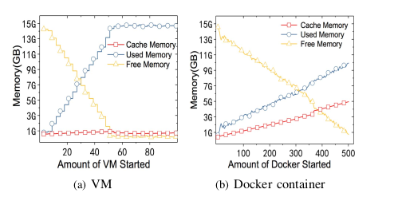
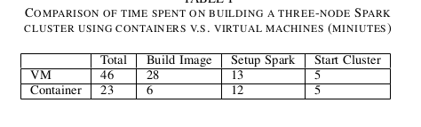
SUMMARY
3) Results shows that compared with virtual machines, containers provide a more easy-to-deploy and scalable environment for big data workloads.

Slide 30
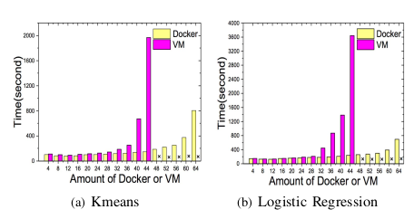
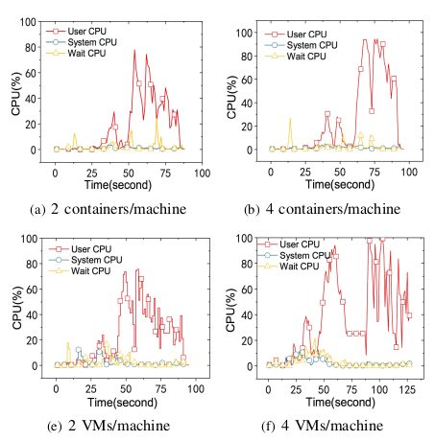
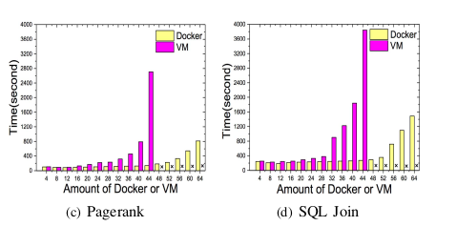
SUMMARY

Slide 31

Thank you

